Slide 1










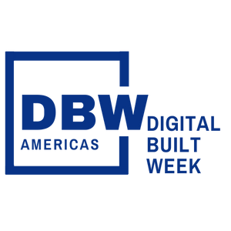

Developing Custom Health Dashboards (with Dynamo and Power BI)
DBWA2023, Session 212
PRESENTATION
Presenters:
Sean McDonald
Corporate BIM Manager
Tieyi Yu
Digital Design Technologist
DIGITAL BUILT WEEK AMERICAS
JUNE 15-17, 2023 | DALLAS, TEXAS

Slide 2
Session Description
'Model health' is a BIM buzzword that frequently lacks specific meaning or universal understanding – by nature, the concept is specific to an organization, project, or even role. Consequently, BIM data must be ‘flexible’ as different project roles require different levels of data detail (or collection rates) to support decisions or be actionable. Dynamo and Power BI are one combination of tools that empowers users to develop DIY model health dashboards. In this lab session, we will walk you through the process of creating those dashboards and underlying data models using Dynamo and Power BI. We will also discuss key considerations for scaling such workflows beyond individual models.
Learning Objectives
At the end of this session, participants will be able to:
Identify sources of model data and run Dynamo scripts to programmatically extract this data to JSON files
Load data into a PowerBI template and automate data extraction, transform, and loading (ETL) tasks
Develop interactive, visually compelling reports and templates to automate your workflow as much as possible.
Note: While you can develop your own health metrics, we provide one for the session.
___________________________________________
Questions related to specific materials, methods, and services will be addressed at the conclusion of this presentation.
DIGITAL BUILT WEEK AMERICAS
Session 212
JUNE 15-17, 2023 | DALLAS, TEXAS
Notes:
Mandatory slide - no need to cover in depth as attendees should know prior to attending but included as a refresher

Slide 3
Motivation / ‘The Problem’
Model Review is Challenging:
Checking Revit models is resource intensive!
Time-consuming, tedious, and inconsistent when performed manually
Not easy to query / search elements in model using Revit UI
Indicators inform adherence to company standards or QA/QC requirements, but importance is specific to company
Need ability to diagnose model health quickly, consistently, on demand
Checks yield info regarding potential model health or performance issues
Better data allows modelers to ask better questions
Some typical questions for models…
How many views are on sheets (or not?)
Is my project using the correct templates or standards?
How many model elements are impacted by warnings?
Is there an unexpected number of object or line styles in the model?
Can I dump model data to Excel for further analysis?
What files are attached to my model?
DIGITAL BUILT WEEK AMERICAS
Session 212
JUNE 15-17, 2023 | DALLAS, TEXAS
Notes:
Since dynamo script and Power BI template already built, typical Revit user should be able to play scripts and generate report on their own
Empowers staff to diagnose issues their own models with a consistent method

Slide 4





One Potential Solution:
Step 0: Initial Setup / File Deployment
Step 1: Update Dynamo scripts to specify output details
Step 2: Run Dynamo scripts on a sample Revit model (produce data outputs as JSON files)
Step 3: Configure Power BI template to read JSON data
Step 4: Refresh and customize Power BI Report
Step 5*: Publish Power BI Report to a workspace (*OPTIONAL: Power BI Pro users only)
STEP 0
STEP 1
STEP 2
STEPS 3-4
STEP 5
DIGITAL BUILT WEEK AMERICAS
Session 212
JUNE 15-17, 2023 | DALLAS, TEXAS

Slide 5

0
1
2
Shortcuts to specific steps in demo
3
LAB INSTRUCTIONS + DEMONSTRATION
4
5
Slides in the next sections are intended to help users recall steps outside of presentation/lab session
We will go over content directly in Dynamo and Power BI rather than talking over slides
Slides with this icon on the top-right corner are discussed in Dynamo / Power BI for the live presentation
DIGITAL BUILT WEEK AMERICAS
Session 212
JUNE 15-17, 2023 | DALLAS, TEXAS
Notes:
This slide deck serves two purposes:
Use in live session presentation, but will skip over certain slides demonstrated live
For self-paced instructions if followed outside of live demo
Thus, the actual presentation is shorter for the live demo, but longer in case users want the main details presented live.

Slide 6
Lab Requirements and Initial Setup
Software Requirements
Revit 2021 (or later)
Dynamo (+3 packages)*:
archi-lab.net (2023.213.1722)
Spring Nodes
JsonData (2.0.2)
*NOTE: We have reduced the number of required packages from the original proposal to reduce chances of conflicts or errors
Power BI
Use Desktop (free) to edit and customize template
Have April 2023 update (or later) installed
If you have Pro (paid), you may also publish reports
Helpful to already have a workspace you can publish to
DIGITAL BUILT WEEK AMERICAS
Session 212
JUNE 15-17, 2023 | DALLAS, TEXAS
Notes:
No need to cover in depth since info was in the lab description so
Just remind about requirements
lab is intended for Revit 2021
Dynamo packages
Power BI requirements (April 2023 or later)

Slide 7
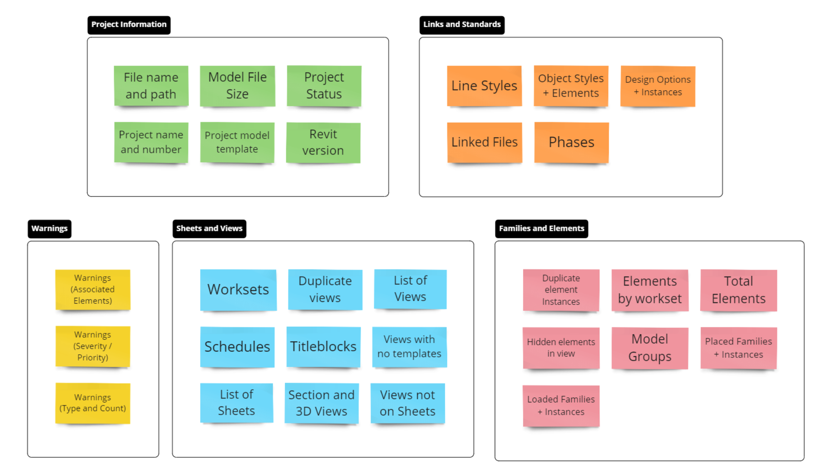
What indicators / metrics are we capturing?
NOTE:
List is NOT comprehensive
Groupings are subjective
Indicators represents primary data of interest that are actionable AND can be extracted from a Revit model. A good start for any model health report!
DIGITAL BUILT WEEK AMERICAS
Session 212
JUNE 15-17, 2023 | DALLAS, TEXAS
Notes:
Goal of the report is to provide actionable information.
Actionable means there is enough info to further investigate in model
Some indicators are company specific – e.g. nomenclature for templates, line styles, etc.
Project Info, Links, and Standards provide context: they don’t necessarily impact model health, but could help diagnose issues if performance was poor

Slide 8
0
1
2
3
4
5
Step 0:
SETUP AND DEPLOYMENT
DIGITAL BUILT WEEK AMERICAS
Session 212
JUNE 15-17, 2023 | DALLAS, TEXAS

Slide 9
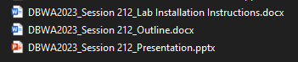
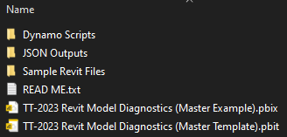
0
1
Step 0: File Deployment
2
3
Folder: DBWA Deliverables
Goal:
Download repo to machine
Create Output Folder for JSON files
Option 1: Create your own
Option 2: just our sample directory
4
5
Folder: DBWA Demonstration Files
DIGITAL BUILT WEEK AMERICAS
Session 212
JUNE 15-17, 2023 | DALLAS, TEXAS
Notes:
Aside:
Each JSON output allows you to specify a different output path.
You can modify each script so all JSON files use the same Project folder for outputs (i.e. use a single node)

Slide 10
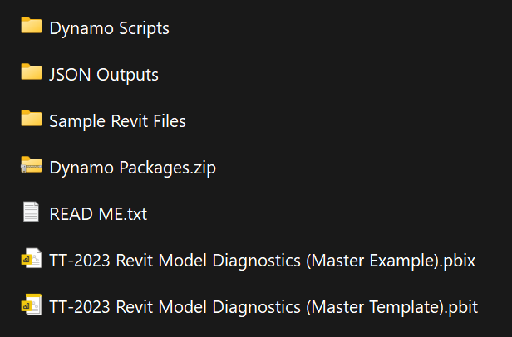
0
1
Step 0 (cont.): Copy our Folder templates
2
3
Goal:
Set up sample Project folder to collect JSON outputs
For demo, create parent folder on your machine: C:\_scratch\
COPY all contents of …\DBWA Demonstration Files\ folder to new parent folder
4
5
Folder: …\DBWA Demonstration Files\
NOTE: JSON outputs can be anywhere as long as outputs from same run are located in the same folder
DIGITAL BUILT WEEK AMERICAS
Session 212
JUNE 15-17, 2023 | DALLAS, TEXAS
Notes:
Notes:
Each JSON output allows you to specify a different output path.
You can modify each script so all JSON files use the same Project folder for outputs (i.e. use a single node)
Not necessary to have Power BI templates, Revit files, or Dynamo scripts in file structure, but is convenient
JSON outputs can be anywhere as long as outputs from same run are located in the same folder

Slide 11
(messed up)
^
Step 0 (cont.): Use our Sample Model
Goal:
Based on Revit’s advanced sample model
Errors / issues added to model to demonstrate report features
Show copy-paste screenshots to make this simpler
Text call-outs for the specific folders using the template folder
DIGITAL BUILT WEEK AMERICAS
Session 212
JUNE 15-17, 2023 | DALLAS, TEXAS
Notes:
Aside:
Each JSON output allows you to specify a different output path.
You can modify each script so all JSON files use the same Project folder for outputs (i.e. use a single node)

Slide 12
0
1
2
3
4
5
Steps 1+2:
DYNAMO SCRIPTS
DIGITAL BUILT WEEK AMERICAS
Session 212
JUNE 15-17, 2023 | DALLAS, TEXAS

Slide 13
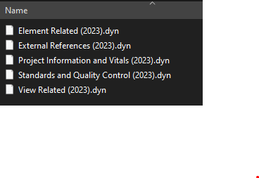
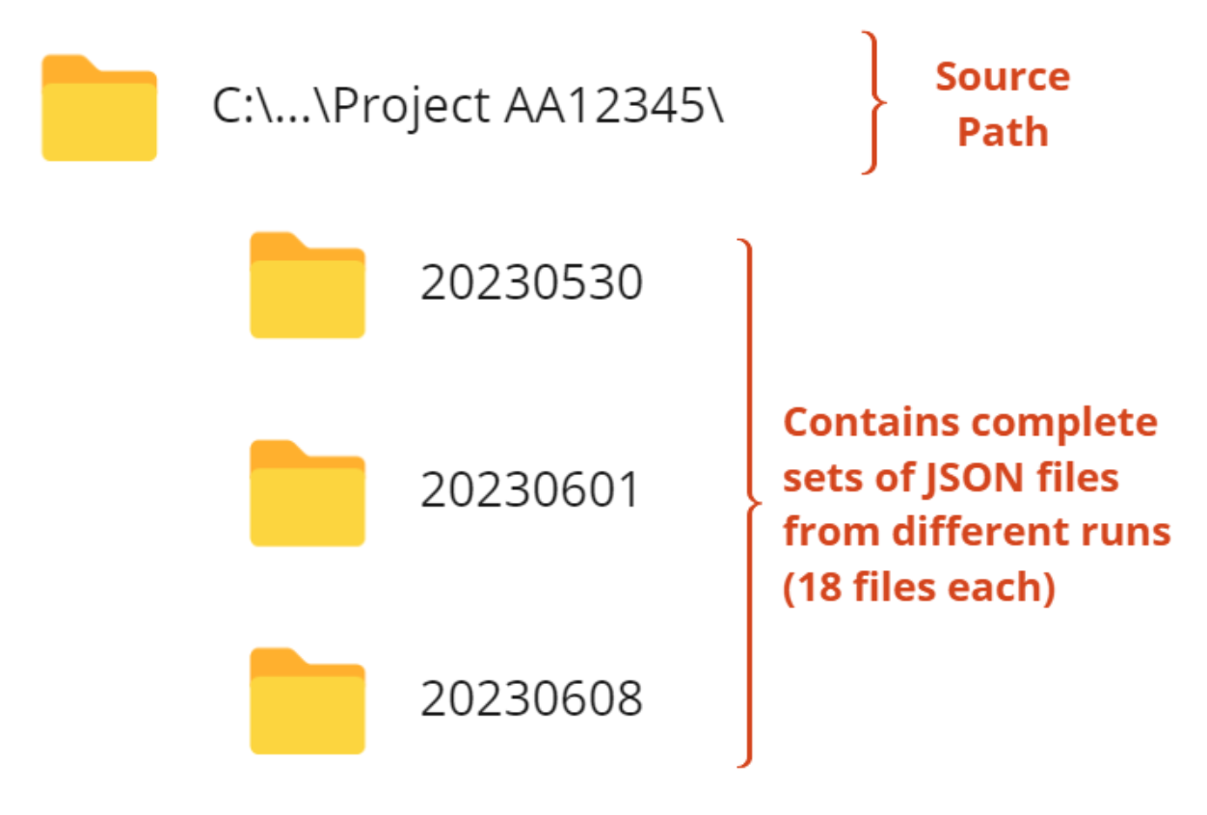
0
1
Step 1: Update Dynamo Scripts
2
3
Goal:
Each Dynamo Script exports multiple JSON files, but users need to update each w/ desired output path
For each Dynamo find pink-colored Groups, verify or update the following nodes to your needs:
Directory Path (required) – where the JSON files should do
Filename Prefix (optional) – if you need to distinguish file
4
5
5 Dynamo Scripts are located within Repo: …\DBWA Demonstration Files\Dynamo Scripts
DIGITAL BUILT WEEK AMERICAS
Session 212
JUNE 15-17, 2023 | DALLAS, TEXAS
Notes:
Aside:
Each JSON output allows you to specify a different output path.
You can modify each script so all JSON files use the same Project folder for outputs (i.e. use a single node)

Slide 14
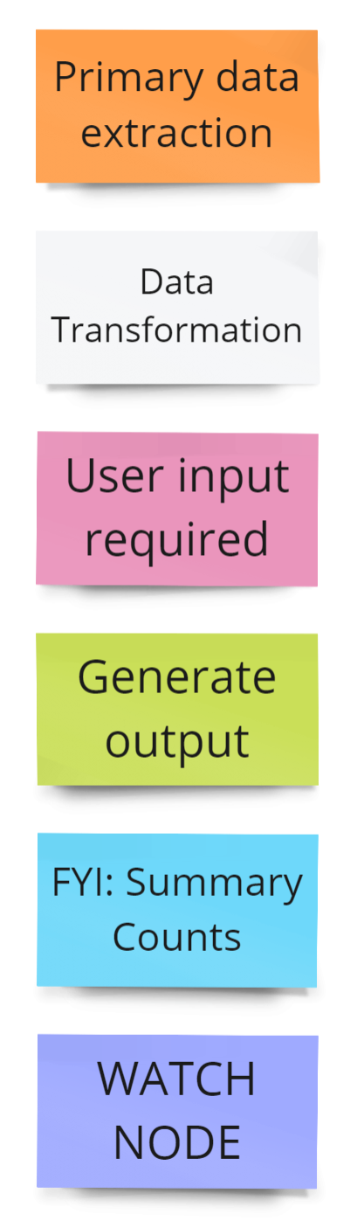
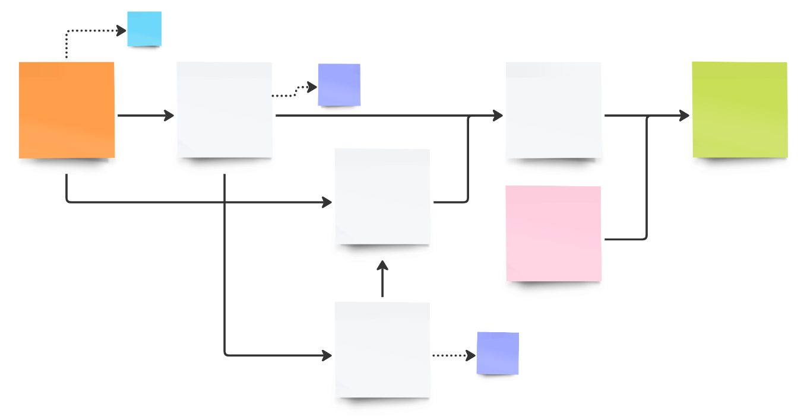
Step 1 (cont): Interpreting the Dynamo maps
Explanation
All scripts generally follow same structure
Get data -> ETL -> export as dictionary
Groups are color-coded
Lines dashed if not contributing to outputs
We will walk through one file in depth to show you primary components
Group Color | Description
Orange | Primary data extraction steps; sets scope of extracted data
Grey | Includes data transformations, e.g. filtering, sorting, reshaping,
Pink | User input is required; typically for choosing file path for output
Green | Output is created; typically a JSON output from a dictionary
Blue | Summary level counts are created (for auditing purposes only)
Purple | Indicates a watch step (for readability or auditing purposes only)
NOTE: Hi-Res Images of EACH map are located within the Dynamo Scripts folder
DIGITAL BUILT WEEK AMERICAS
Session 212
JUNE 15-17, 2023 | DALLAS, TEXAS

Slide 15
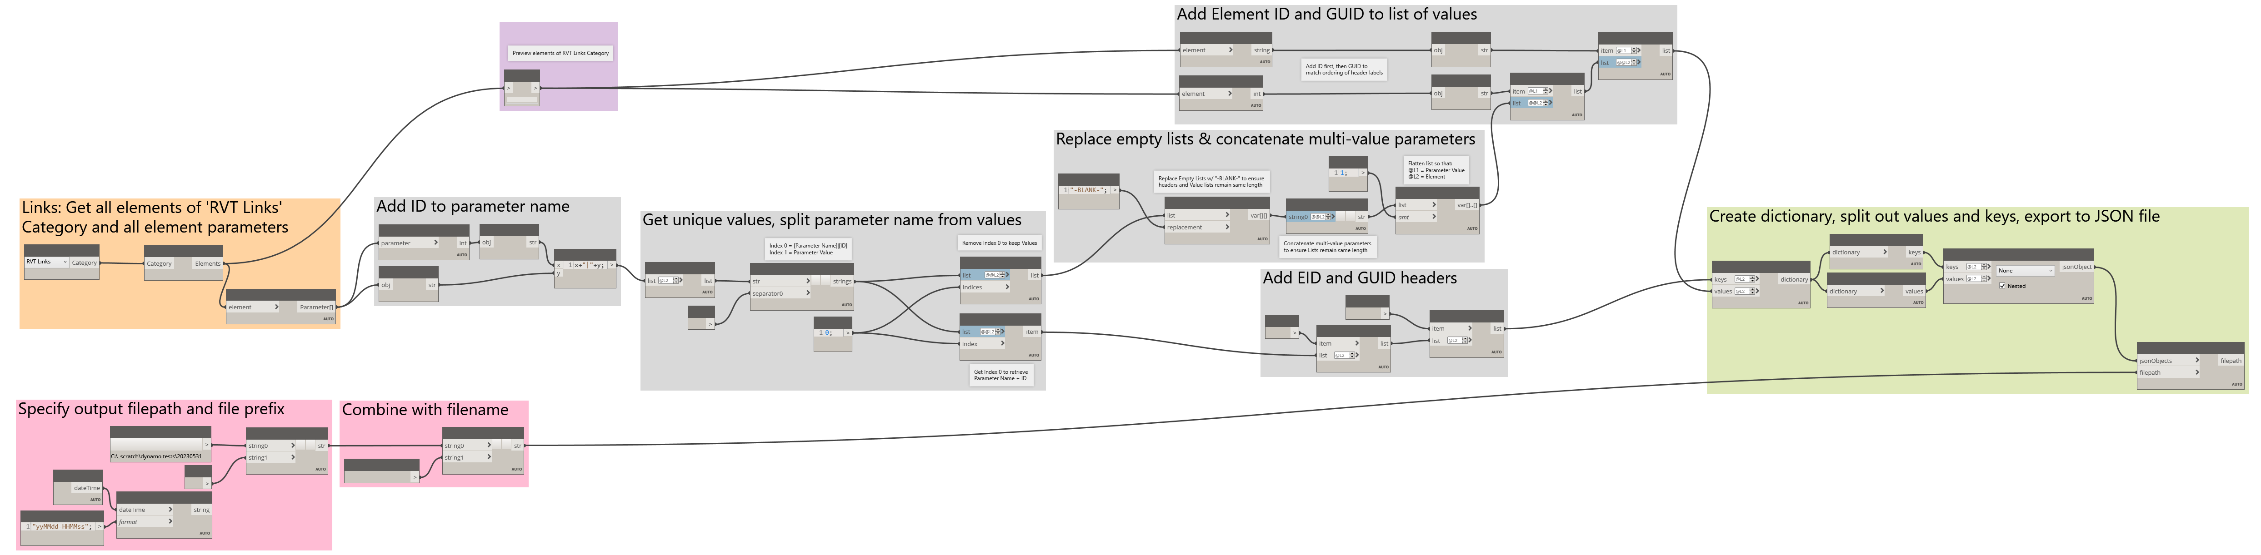
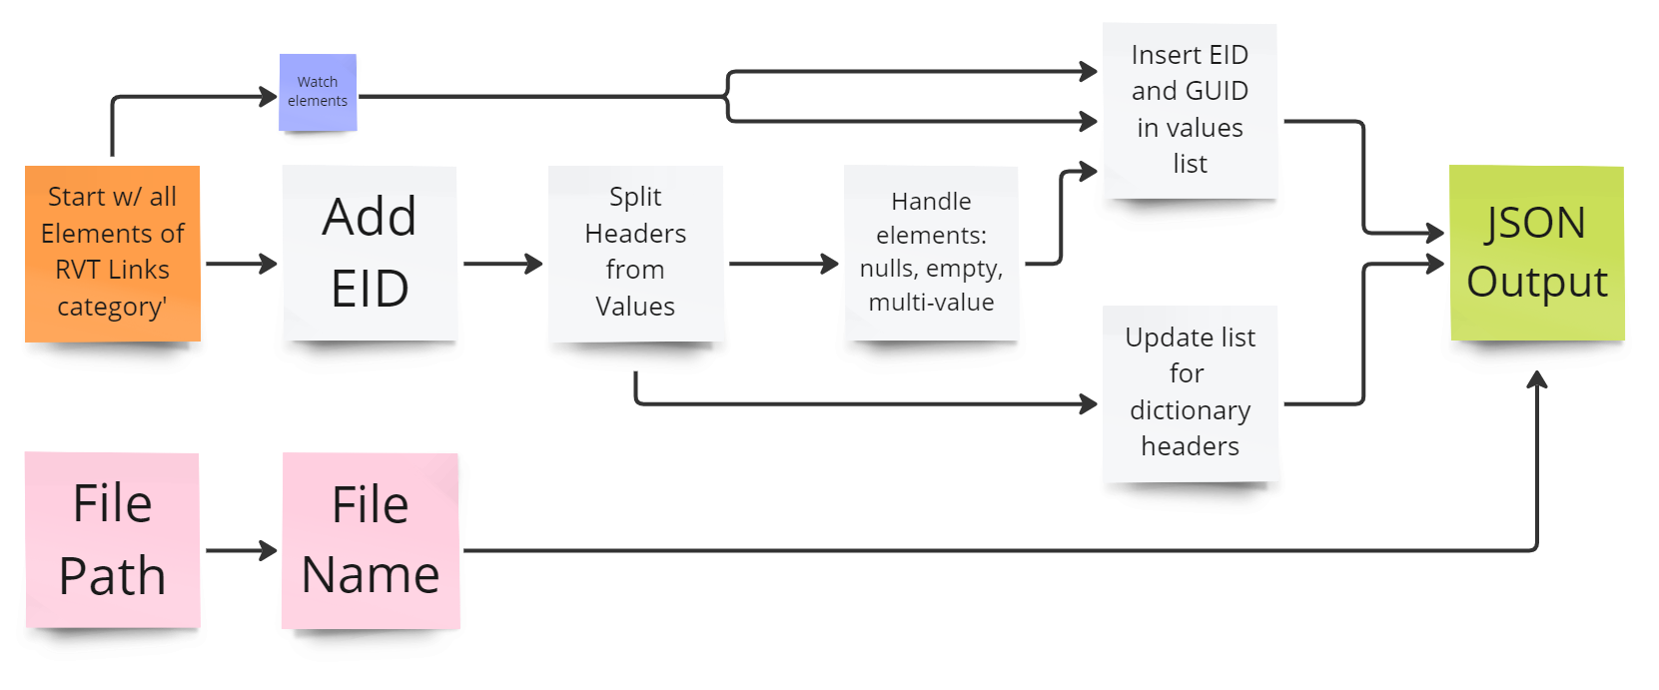
Step 1 (cont): External References (Walkthrough)
Simplified equivalent diagram based on just the groups
DIGITAL BUILT WEEK AMERICAS
Session 212
JUNE 15-17, 2023 | DALLAS, TEXAS
Notes:
A few notes before switching to Dynamo:
More detailed explanation of steps in comments of each Dynamo map
Each Dynamo script has a PNG file located within the same folder
Use our sample JSON output files to skip running Dynamo playlists

Slide 16
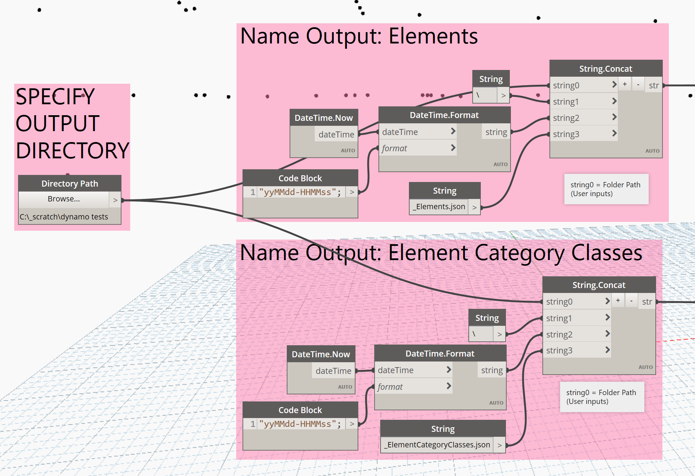
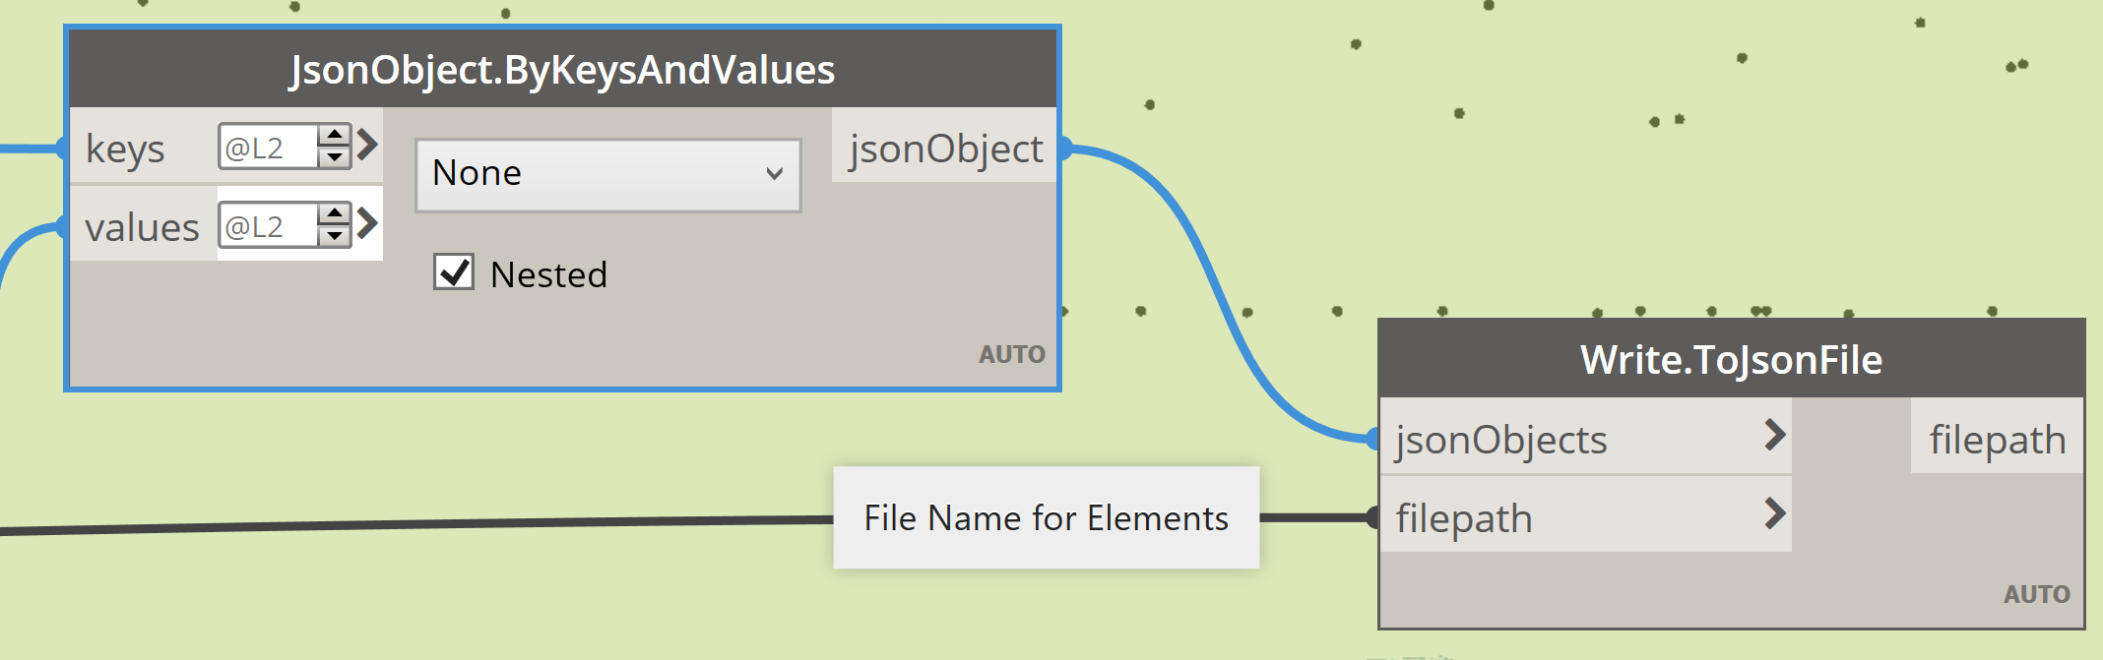
0
Step 1 (cont.): Update Dynamo Scripts
1
2
Update this node to the same value for EACH Dynamo script before running
3
4
For each JSON output, a dynamo map ends with a green Group of nodes, specifically the ‘Write.ToJSON File’ node
5
Strings feed into respective final ‘Write.toJsonFile’ input for their nodes
You may change the name of the file, but then you must Power BI report to recognize the new file name!
DIGITAL BUILT WEEK AMERICAS
Session 212
JUNE 15-17, 2023 | DALLAS, TEXAS
Notes:
Aside:
Each JSON output allows you to specify a different output path.
You can modify each script so all JSON files use the same Project folder for outputs (i.e. use a single node)

Slide 17
Step 1 (cont): External References (Walkthrough)
Watch node helps developers audit elements list before transformations
Get parameter IDs and values, combine to single string for each element
Start with all elements of the ‘RVT Links’ category
Specify output folder path
Specify output JSON file name, then combine with directory to recreate full file path for data export
DIGITAL BUILT WEEK AMERICAS
Session 212
JUNE 15-17, 2023 | DALLAS, TEXAS

Slide 18
Step 1 (cont): External References (Walkthrough)
Remove empty lists and null value; concatenate parameters with multiple values into single entry. Then flatten to preserve length length and structure
Use for Dictionary Values
Add EID and GUID values to front of lists in correct sequence
Use for Dictionary Keys
Add EID and GUID headers to front of lists in correct sequence
After getting unique values, split parameter names (headers) from values
DIGITAL BUILT WEEK AMERICAS
Session 212
JUNE 15-17, 2023 | DALLAS, TEXAS

Slide 19

Step 1 (cont): External References (Walkthrough)
Move on to other Dynamo scripts…
Create dictionary using headers and values, then export to JSON file using path and name specified in Pink group nodes
DIGITAL BUILT WEEK AMERICAS
Session 212
JUNE 15-17, 2023 | DALLAS, TEXAS

Slide 20
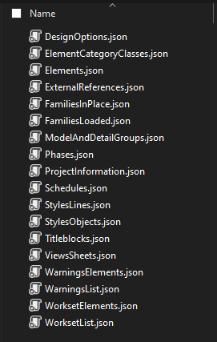
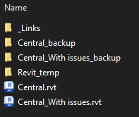
0
1
Step 2: Run Dynamo Scripts
2
3
Goal:
Use your own model or our sample Revit 2021 model, Central_With issues.rvt
Run all 5 Dynamo scripts on your model using Dynamo Player
Model is modified version of a sample Autodesk model
Larger models take more time; please be patient!
4
5
5 Dynamo Scripts are located within Repo: …\DBWA Demonstration Files\Dynamo Scripts
Running Dynamo Scripts should result in creation of 18 JSON files
DIGITAL BUILT WEEK AMERICAS
Session 212
JUNE 15-17, 2023 | DALLAS, TEXAS

Slide 21
Step 2: Collect JSON Outputs
We just reviewed ‘External References’ one in live demo
Table maps relationship between Dynamo maps and JSON output files
Dynamo Map File | JSON Output
Project Information and Vitals (2023).dyn | ProjectInformation.json
 | WarningsList.json
 | Warnings.json
View Related (2023).dyn | Schedules.json
 | ViewsSheets.json
 | Titleblocks.json
Standards and Quality Control (2023).dyn | StylesObjects.json
 | StylesLines.json
 | Phases.json
Standards and Quality Control (2023).dyn | DesignOptions.json
Dynamo Map File | JSON Output
Element Related (2023).dyn | ModelAndDetailGroups.json
 | FamiliesLoaded.json
 | FamiliesInPlace.json
 | Worksets.json
 | WorksetElements.json
Element Details (2023).dyn | Elements.json
 | ElementCategoryClasses.json
External References (2023).dyn | ExternalReferences.json
PUT ALL JSON FILES FROM THE SAME RUN IN THE SAME FOLDER!
DIGITAL BUILT WEEK AMERICAS
Session 212
JUNE 15-17, 2023 | DALLAS, TEXAS

Slide 22
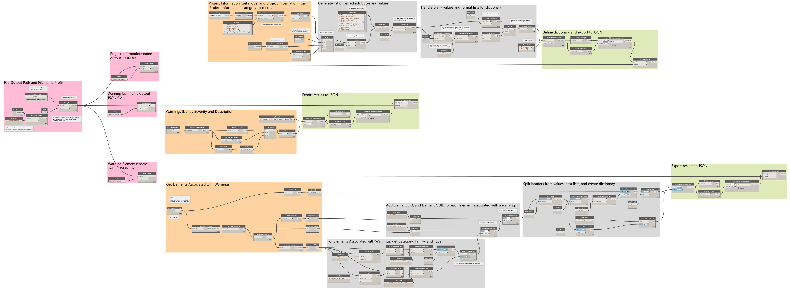
Step 2 (cont): Project Information & Vitals
JSON Outputs:
Project Information
Warnings
Warning Elements
NOTE: Hi-Res Images of EACH map are located within the Dynamo Scripts folder
NOTE: All Dynamo maps include additional comments within the map files to help inform logic
DIGITAL BUILT WEEK AMERICAS
Session 212
JUNE 15-17, 2023 | DALLAS, TEXAS

Slide 23
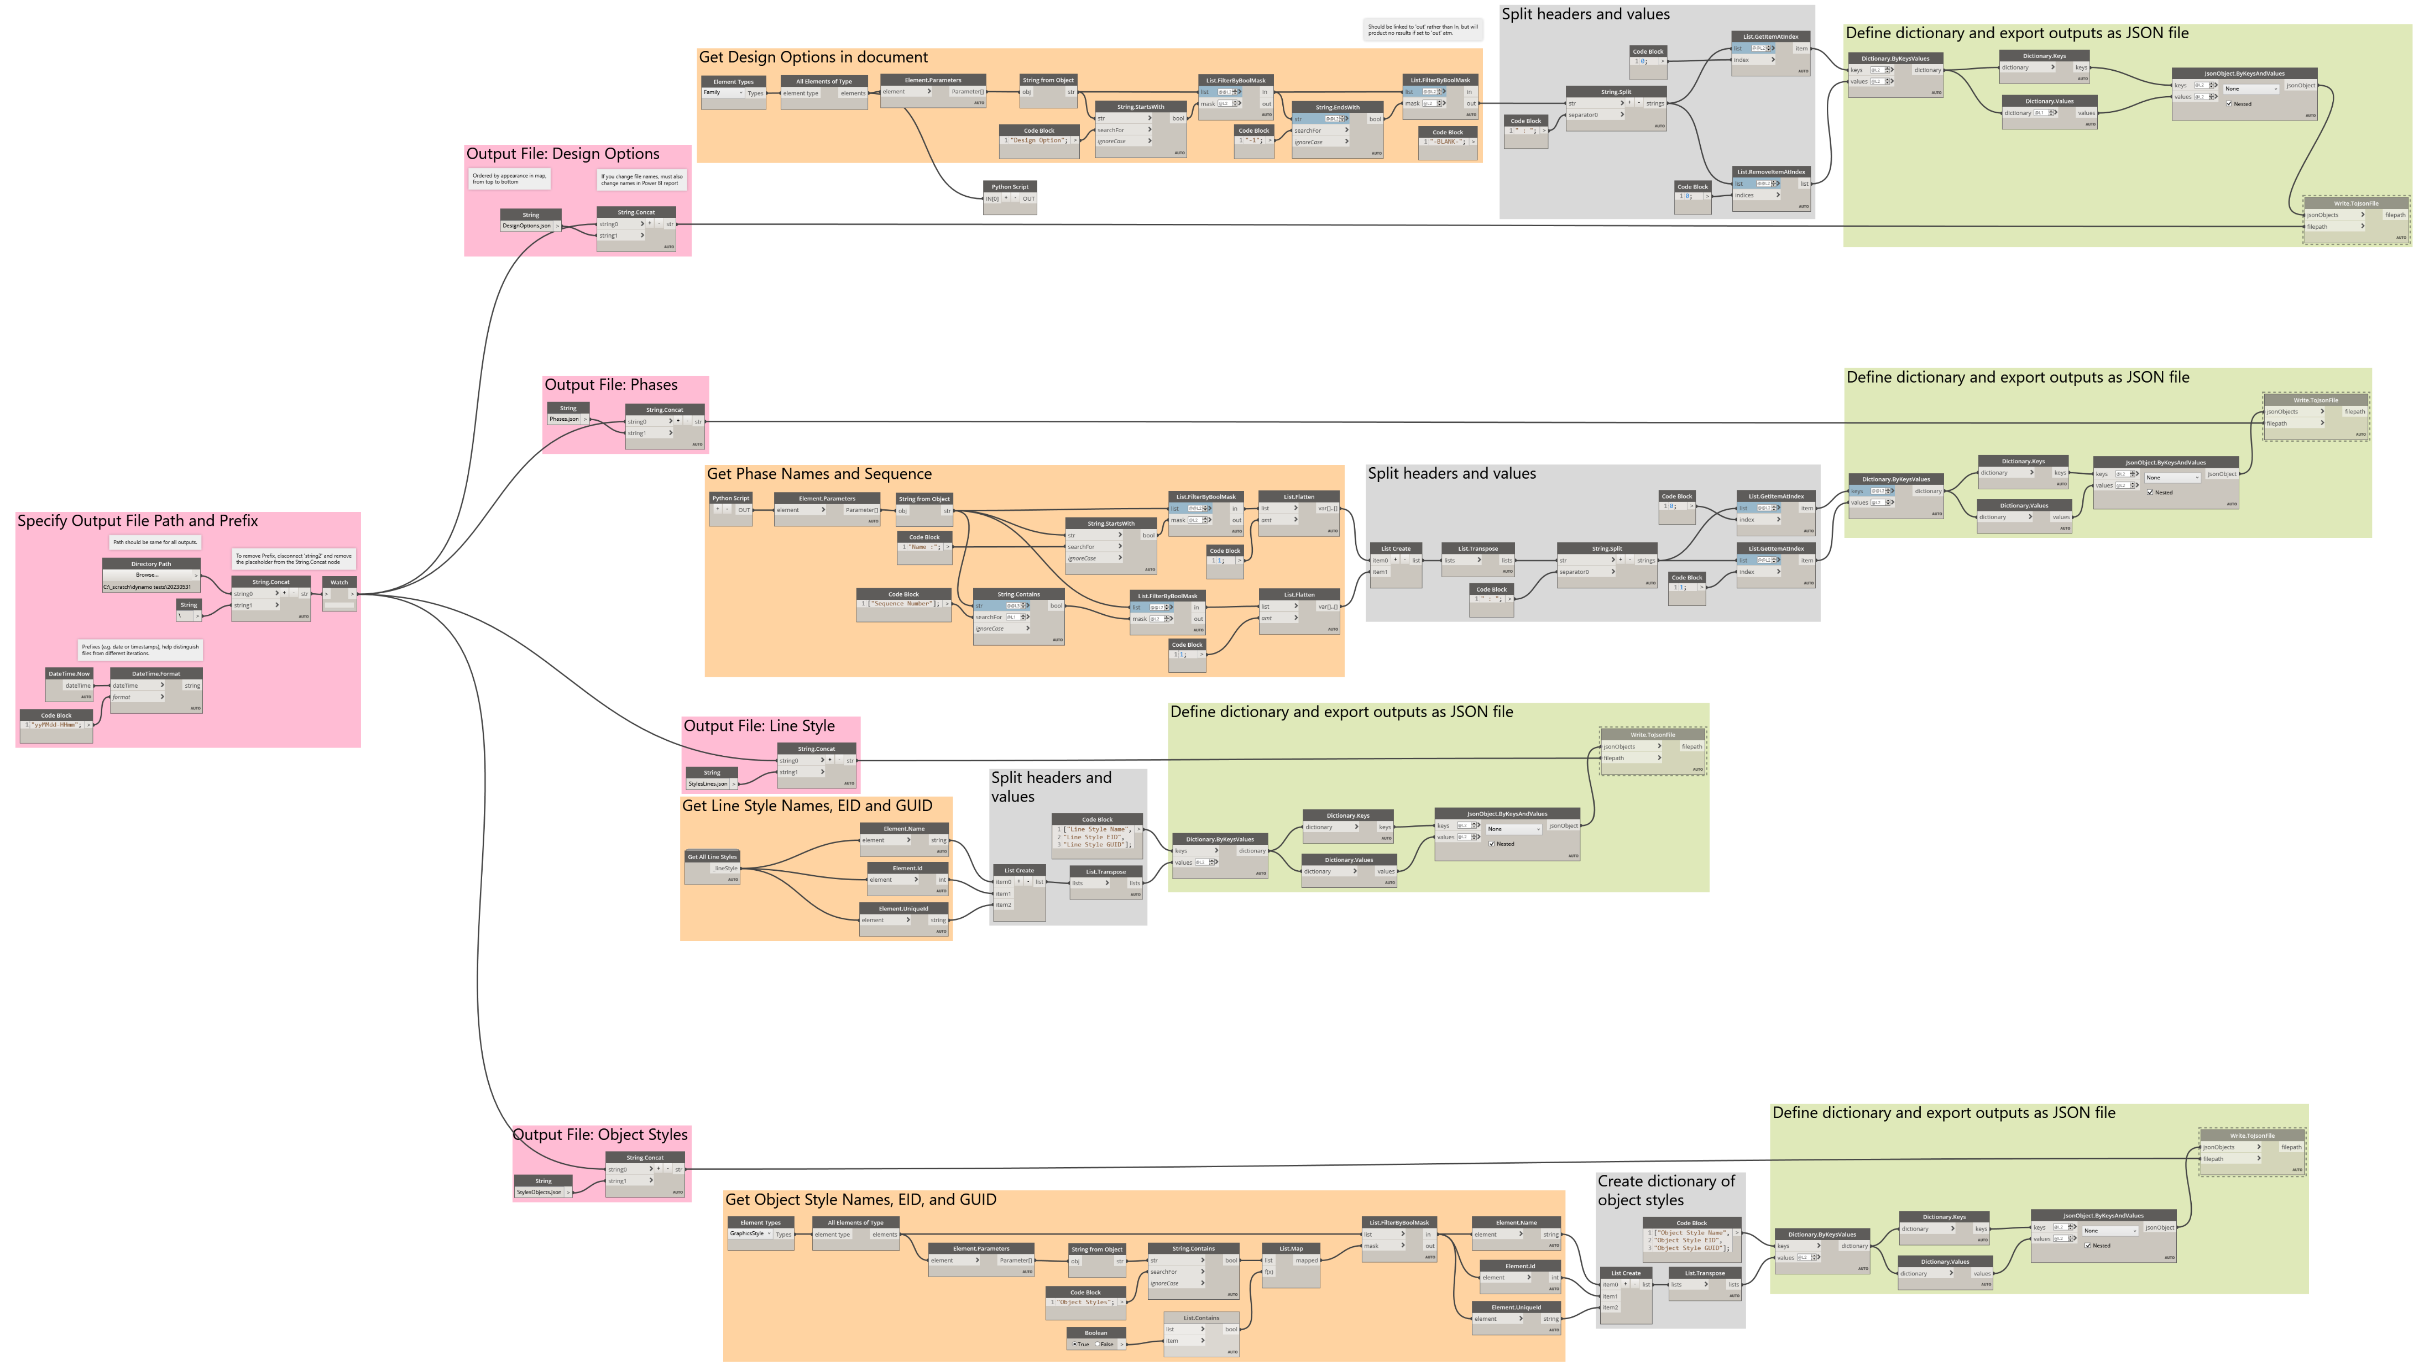
Step 2 (cont): Standards and QC
JSON Outputs:
Design Options
Phases
Line Styles
Object Styles
NOTE: Hi-Res Images of EACH map are located within the Dynamo Scripts folder
NOTE: All Dynamo maps include additional comments within the map files to help inform logic
DIGITAL BUILT WEEK AMERICAS
Session 212
JUNE 15-17, 2023 | DALLAS, TEXAS

Slide 24
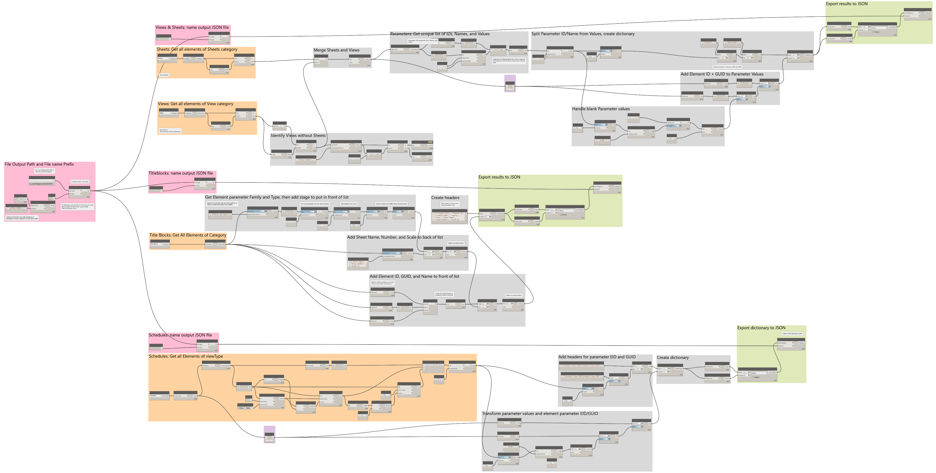
Step 2 (cont): View Related
JSON Outputs:
Views
Sheets
Titleblocks
Schedules
NOTE: Hi-Res Images of EACH map are located within the Dynamo Scripts folder
NOTE: All Dynamo maps include additional comments within the map files to help inform logic
DIGITAL BUILT WEEK AMERICAS
Session 212
JUNE 15-17, 2023 | DALLAS, TEXAS

Slide 25
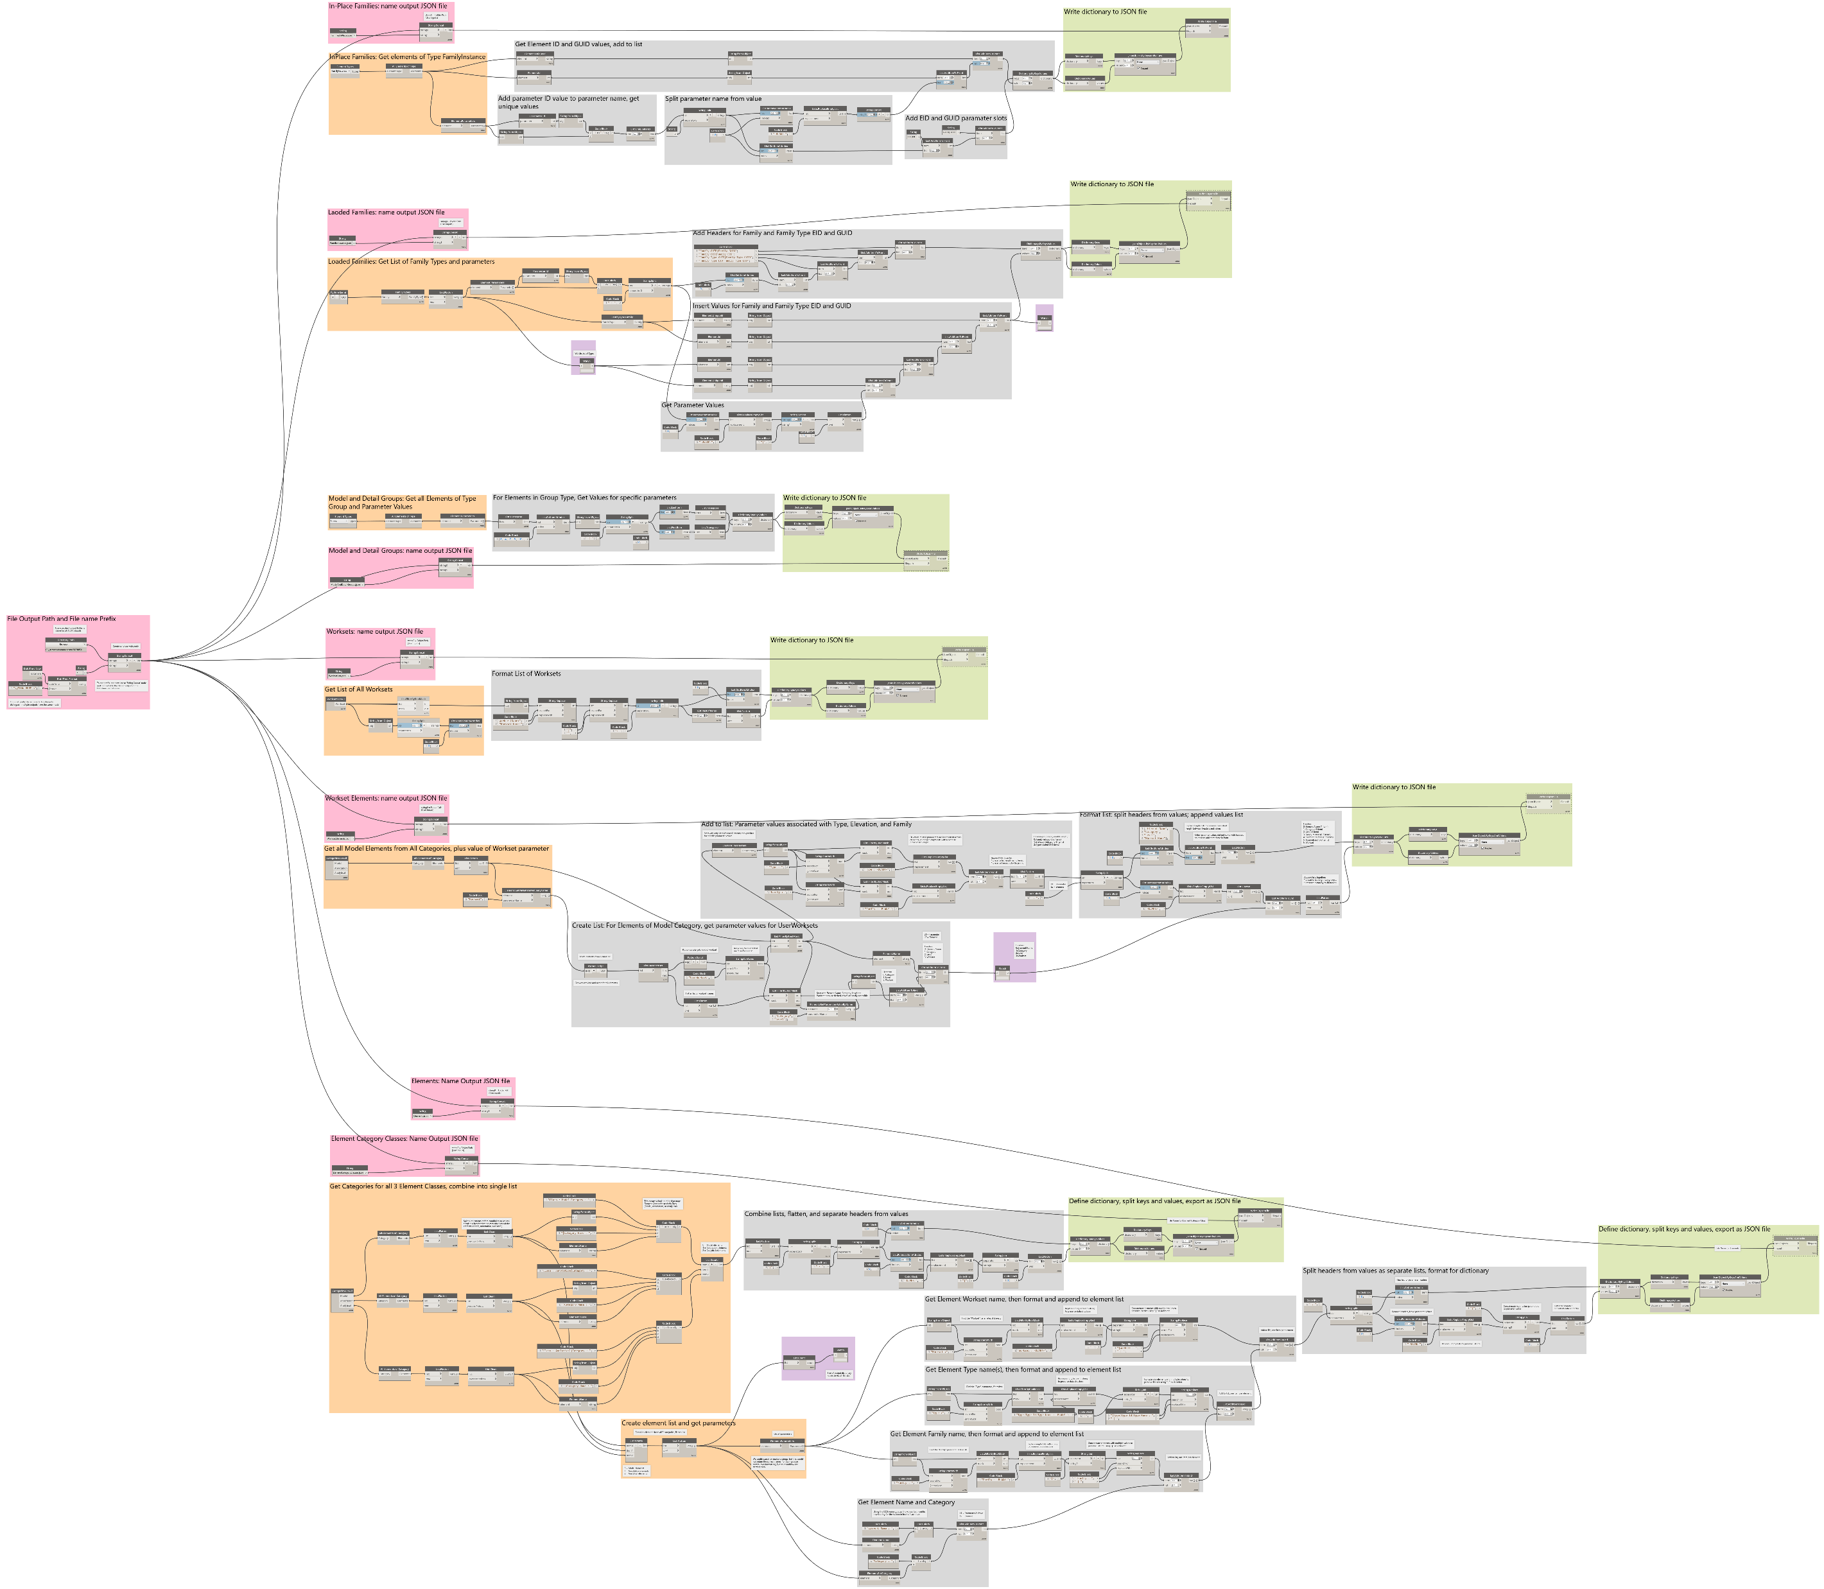
Step 2 (cont): Element Related (Part 1)
JSON Outputs:
Placed Families
Loaded Families
Model & Detail Groups
Worksets
Worksets
NOTE: Hi-Res Images of EACH map are located within the Dynamo Scripts folder
NOTE: All Dynamo maps include additional comments within the map files to help inform logic
DIGITAL BUILT WEEK AMERICAS
Session 212
JUNE 15-17, 2023 | DALLAS, TEXAS

Slide 26
Step 2 (cont): Element Related (Part 2)
JSON Outputs (cont.):
Workset Elements
Elements
Element Category Classes
NOTE: Hi-Res Images of EACH map are located within the Dynamo Scripts folder
NOTE: All Dynamo maps include additional comments within the map files to help inform logic

Slide 27
0
1
2
3
4
5
Steps 3-5:
POWER BI REPORT
DIGITAL BUILT WEEK AMERICAS
Session 212
JUNE 15-17, 2023 | DALLAS, TEXAS

Slide 28
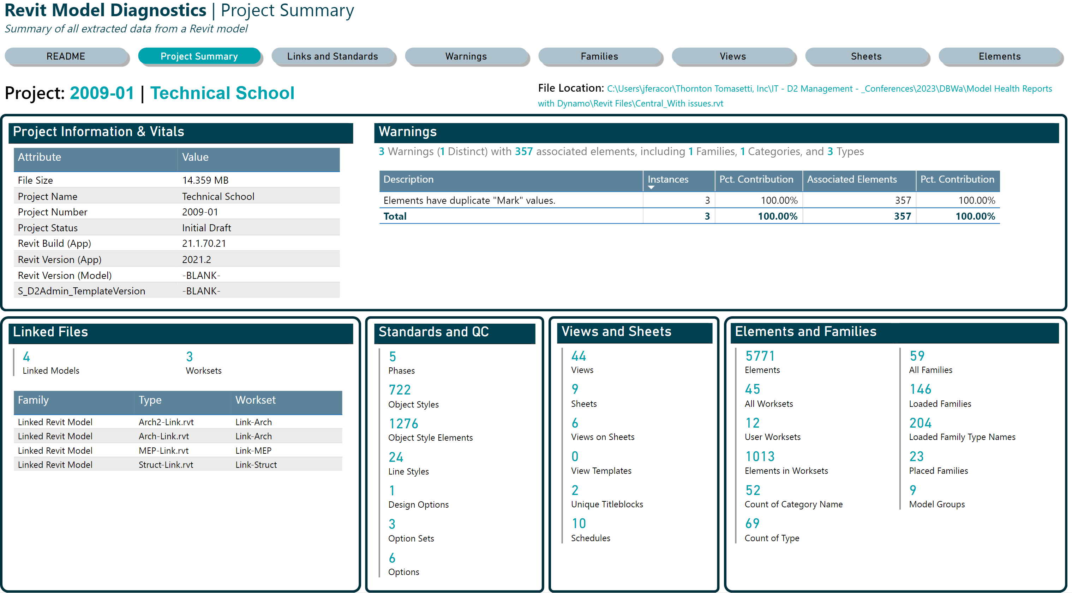
Tour of the Power BI Report…
Notes:
Demonstrate the web-version of the Power BI report to show what user sees when consuming report
Can use PBI Desktop if audience more oriented to development
Link to D2’s Published Report: (only works for Digital Design staff at TT)

Slide 29
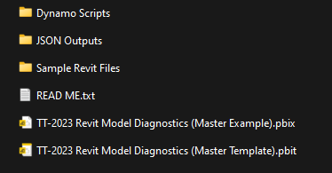
0
1
Step 3: Load Data into Power BI
2
3
Goal
Populate Power BI report with data from Dynamo (JSON files)
Two options:
Use Completed Example (PBIX file)
Data already loaded; can be further modified
Not prompted for data when opening
Use Template (PBIT file)
No data loaded
Prompt for parameter values upon opening
Will also Refresh data (i.e. Step 4 completed too)
4
Folder: …\DBWA Demonstration Files\
5
Recommendation:
Use the Completed Example to skip the Dynamo stuff and focus on modifying the report
Use the blank Template to demo the entire process
DIGITAL BUILT WEEK AMERICAS
Session 212
JUNE 15-17, 2023 | DALLAS, TEXAS

Slide 30
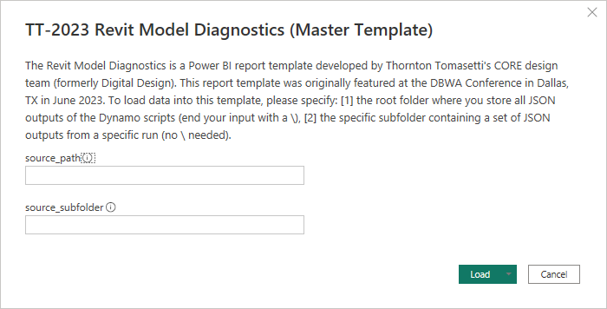
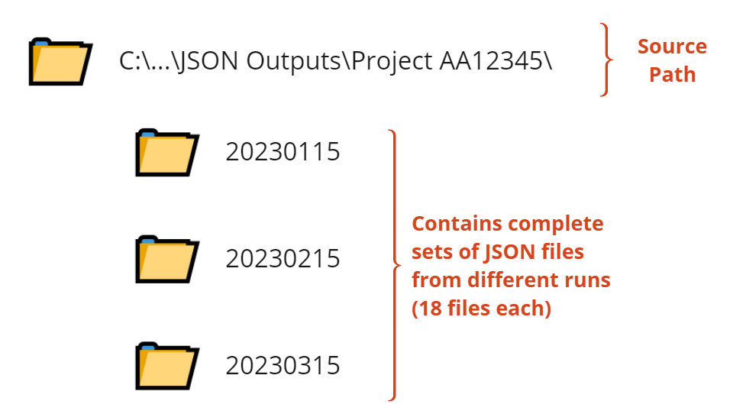
Step 3 (cont.): Load Data using Template
Goal: (When opening a blank Power BI template – PBIT file)
Template will ask user for 2 parameter values open opening:
source_path = root folder of the JSON folder
source_subfolder = subfolder containing set of JSON output files
PLEASE REMEMBER TO INCLUDE A ‘\’ AT THE END OF THE SOURCE PATH
e.g. C:\...\JSON Outputs\Project AA12345\
NO ‘\’ NEEDED FOR SUBFOLDER
e.g. 20230617
When you press Load, data is also refreshed!
DIGITAL BUILT WEEK AMERICAS
Session 212
JUNE 15-17, 2023 | DALLAS, TEXAS

Slide 31
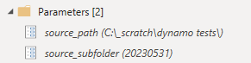
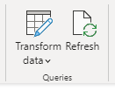
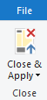
0
1
Step 4: Modify/Refresh Data in existing report
2
3
4
Goal: (When using an existing, pre-populated file – PBIX file)
In Power BI Power Query Editor, you can
update the 2 parameters in template
View and modify ETL steps from existing queries
load additional queries/tables into report
5
In Power BI Report Editor, you can
refresh changes made to data sources
refresh changes to a single table
apply changes from Power Query too
2 parameters:
source_path
source_file
In the Home ribbon of the Power Query Editor, Press Close & Apply after making changes to queries
In the Home ribbon of the Power BI Report Editor, click ‘Refresh’ in the Queries section
Prefer to do additional ETL in Power Query if changes do not require data from other tables
Use DAX in Report Editor to perform additional calculations that require information spanning multiple tables
DIGITAL BUILT WEEK AMERICAS
Session 212
JUNE 15-17, 2023 | DALLAS, TEXAS

Slide 32
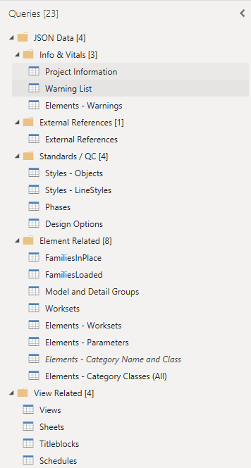
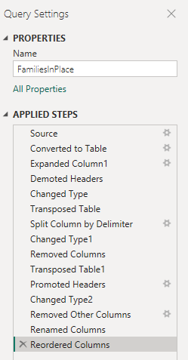
Step 4 (cont): Modify ETL in Power Query
Folder containing set of JSON files
JSON files loaded into tables(queries) in Power Query Editor of Power BI
Review or modify ETL steps by inspecting the ‘Applied Steps’ of any Table Query
Tables
Modified copy ‘Elements – Category Classes (All)’
Disabled from Load after merging contents to Elements – Parameters
DIGITAL BUILT WEEK AMERICAS
Session 212
JUNE 15-17, 2023 | DALLAS, TEXAS

Slide 33
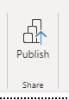
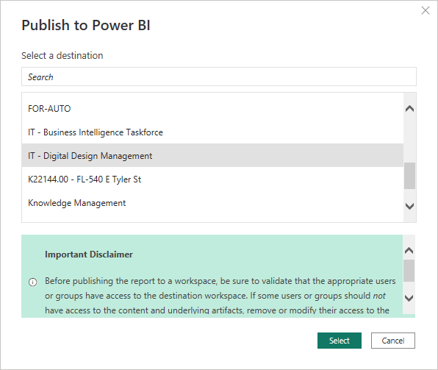
0
1
Step 5: Publish report to a Power BI workspace
2
3
Goal:
Publish the completed report to a Power BI Workspace using a Power BI Pro license
Publish using Power BI Desktop, but workspaces are only available with Power BI Pro
Go to Web Service to inspect results
Get a Share link or embed in Microsoft Teams
4
In Report Editor, go to Home ribbon, then press Publish…
5
Why do this?
Publishing and refresh automation
Smoother user experience when data is pre-loaded
Source data / report is preserved; viewers get a copy
Secure web access via persistent URL
Possible to Embed via Teams, PPT
Caveat: Premium feature of most data viz platforms
Choose a workspace, then press Select
DIGITAL BUILT WEEK AMERICAS
Session 212
JUNE 15-17, 2023 | DALLAS, TEXAS

Slide 34
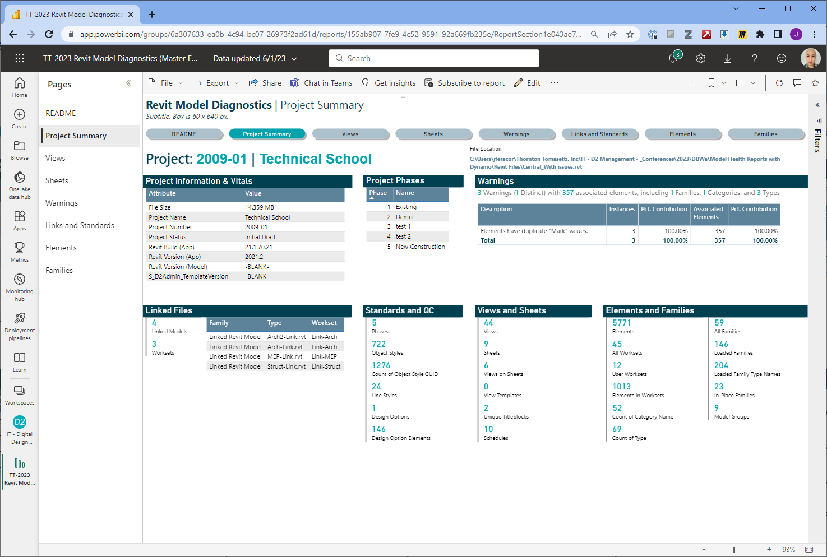
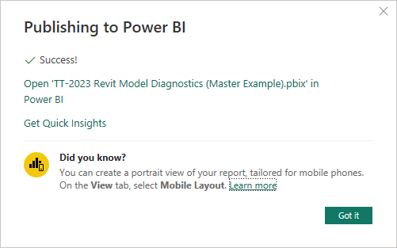
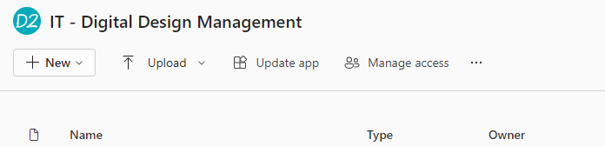
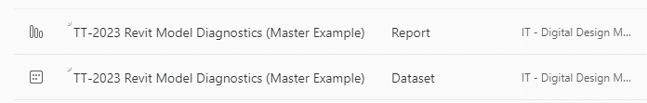
Step 5 (cont.): Inspect in Power BI Service
Goal:
After successful publish, go to app.powerbi.com
Navigate to the destination workspace
Locate board
View the Report, not the Dataset
DIGITAL BUILT WEEK AMERICAS
Session 212
JUNE 15-17, 2023 | DALLAS, TEXAS

Slide 35
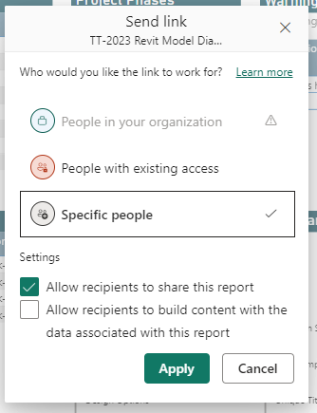
Step 5 (cont.): Get Share URL
Get Share URL by pressing ‘Share’ Button when viewing report
If Power BI workspace is associated with a channel in Microsoft Teams, members automatically gain access
To PDF, image, or PowerPoint embed
DIGITAL BUILT WEEK AMERICAS
Session 212
JUNE 15-17, 2023 | DALLAS, TEXAS

Slide 36
0
1
2
3
4
5
DISCUSSION:
SCALING CONSIDERATIONS
DIGITAL BUILT WEEK AMERICAS
Session 212
JUNE 15-17, 2023 | DALLAS, TEXAS

Slide 37
Discussion: Dynamo Pros and Cons
Discussion Point: Why Dynamo?
Why Dynamo
Its free and installed with Revit
“Easily” modifiable
Consistent, repeatable, methodical
Drawbacks to Dynamo
Can be slow
Must be run manually
Can be prone to issues (e.g. compatability)
Issues can be machine specific
Can’t stop a run without killing Revit
Only 1 playlist at a time
DIGITAL BUILT WEEK AMERICAS
Session 212
JUNE 15-17, 2023 | DALLAS, TEXAS

Slide 38
Discussion: Workflow Scaling and Improvements
In what cases is this workflow ideal?
Depends on maturity of corporate standards
Internal weighting of metrics
What are limitations to workflow?
Data storage requirements
Volume of models vs. reporting frequency
Parallel vs. Series Processing
How can this workflow be scaled?
Proof-of-concept or consumer-ready
Needs for future customization
Scope of Work
precision: automatically identify which models to scan?
reporting frequency: is rate fast enough to be informative / reported soon enough?
Who does the development?
In-house: Dynamo, Revit API
External: Vendors, 3rd Party Contractors
Are metrics captured by other tools?
Ownership and data centralization
Do projects require more nuanced dynamo maps beyond general diagnostics?
Data to be centrally managed or done on demand?
Who maintains library of Dynamo scripts / routines?
What are potential feature improvements?
Multiple models
Compare iterations / Trends over time
DIGITAL BUILT WEEK AMERICAS
Session 212
JUNE 15-17, 2023 | DALLAS, TEXAS

Slide 39

CONCLUSION & WRAP-UP
STEP 0
Download and deploy and set up folder structure
Copy sample model
Set up manually or copy our template
x18
STEP 1-2
Update Dynamo Scripts, run on a model
Generate output data (JSON files)
Configure output files and manually trigger all 5 Dynamo scripts on a mode
x18
STEP 3-4:
Update Power BI Template
Read JSON files / refresh data
Configure Power BI to receive data from 18 JSON file; customize report as needed
POWER QUERY EDITOR
+
REPORT EDITOR
STEP 5: (Optional for Power BI Pro users)
Publish report to a workspace
Publish a report to make report available to others via web browser
PUBLISH REPORT
VIA
POWER BI PRO
DIGITAL BUILT WEEK AMERICAS
Session 212
JUNE 15-17, 2023 | DALLAS, TEXAS

Slide 40

0
1
THANK YOU! QUESTIONS?
2
3
4
Developing Custom Health Dashboards (with Dynamo and Power BI)
5
DBWA2023, Session 212
Sean McDonald
smcdonald@thorntontomasetti.com
Tieyi Yu
tyu@thorntontomasetti.com
James Feracor
jferacor@thorntontomasetti.com
DIGITAL BUILT WEEK AMERICAS
Session 212
JUNE 15-17, 2023 | DALLAS, TEXAS

